Slide 1
Comparative Analysis of Classical, Geometric, and
Modern Approaches for Image Classification and
Detection on MNIST
~ Sushovit Nanda (21283) [Conceptualizing, Methodology, Geometric/ResNet-18/CLIP Studies, Drafting]
~ Lakshay Saini (23166) [Methodology, HOG/LBP/SIFT+BOW Studies, Drafting]

Slide 2
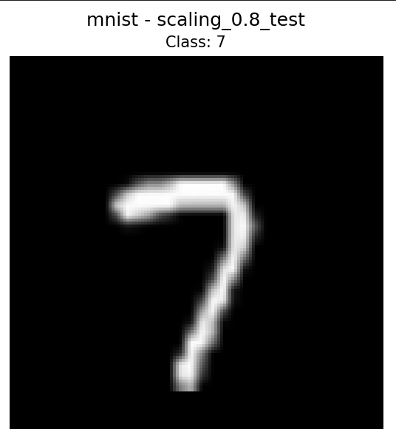
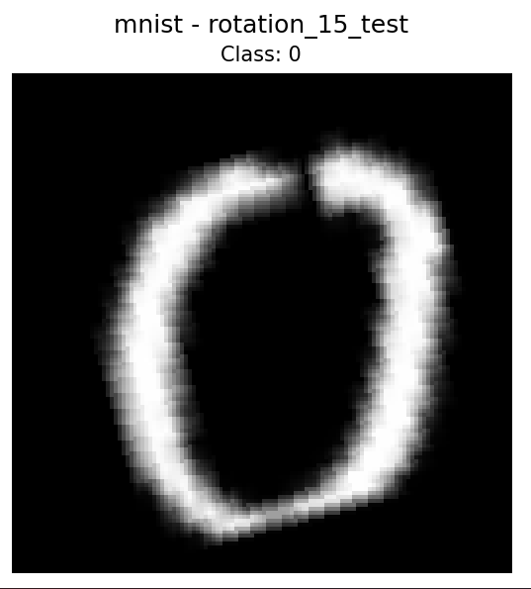
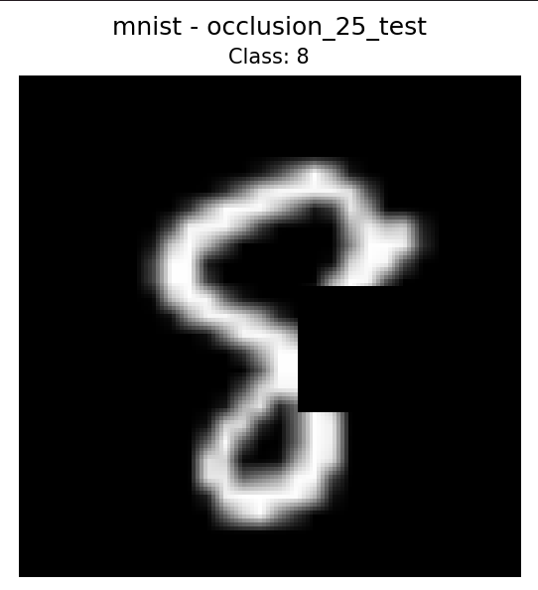
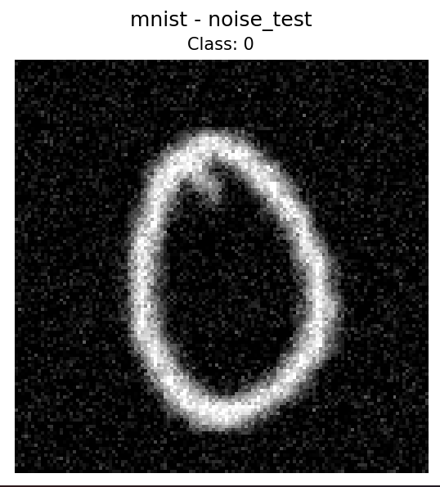
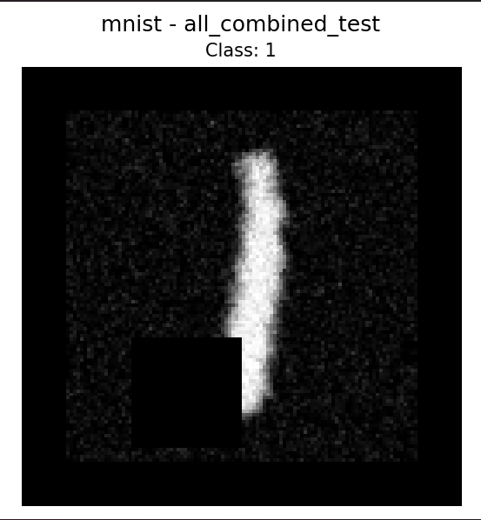
Introduction
The MNIST dataset was normalized and resized to 28 × 28 grayscale. Four augmentations were applied: 15° rotation, 0.8× scaling, 25% occlusion, and Gaussian noise. Three training configurations were used: Original (no augmentation), Mixed-augmented (equal, random application of all four augmentations), and Combined-augmented (all augmentations applied sequentially to every sample).

Slide 3
Traditional Feature Extraction
HOG
Captures shape and edge information through gradient orientations
Divides image into 8×8 pixel cells
Computes histogram of 9 gradient directions (0°-180°) per cell
Normalizes across 2×2 cell blocks for lighting invariance
LBP
Captures local texture patterns by comparing pixel neighborhoods
Compares each pixel to its 8 surrounding neighbors
Creates binary code: "1" if neighbor is brighter, "0" if darker
Generates histogram of uniform patterns (10 bins for 8 neighbors)
SIFT+BOW
Detects scale and rotation-invariant keypoints (corners, blobs, interesting regions)
Extracts 128-dimensional descriptor per keypoint describing local gradients
Variable number of keypoints per image (e.g., 50-200 depending on complexity)

Slide 4
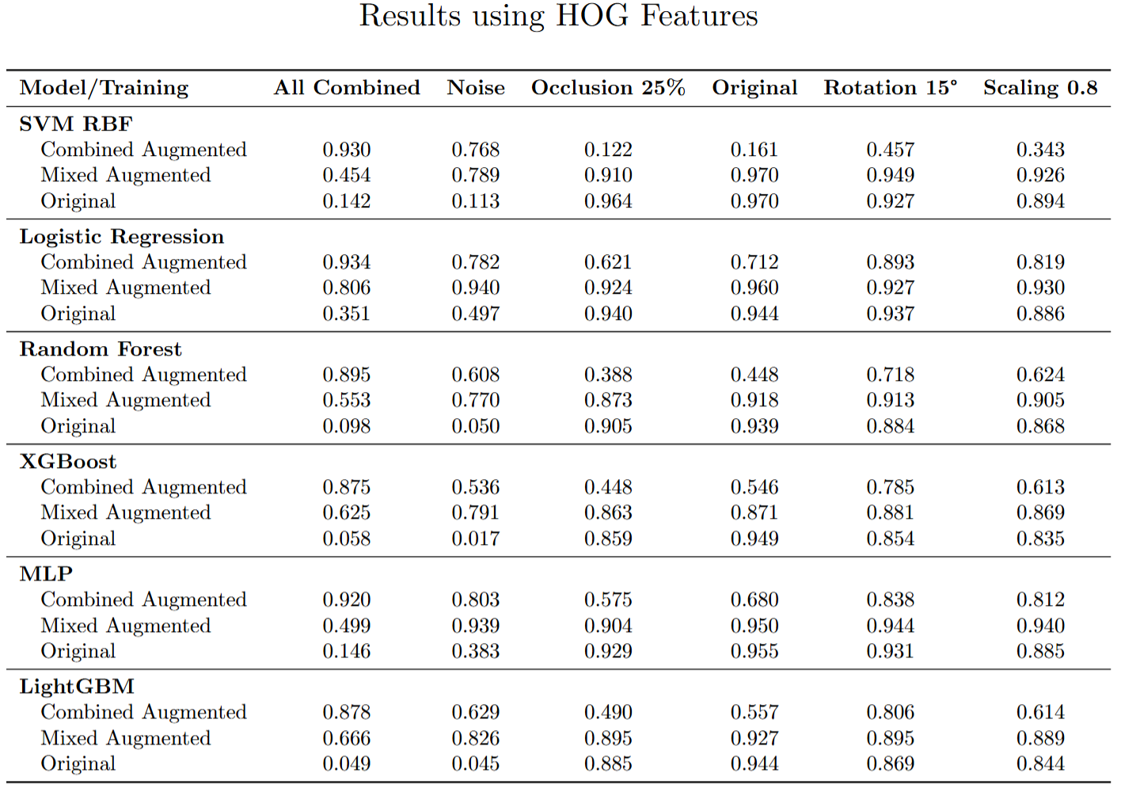

Slide 5
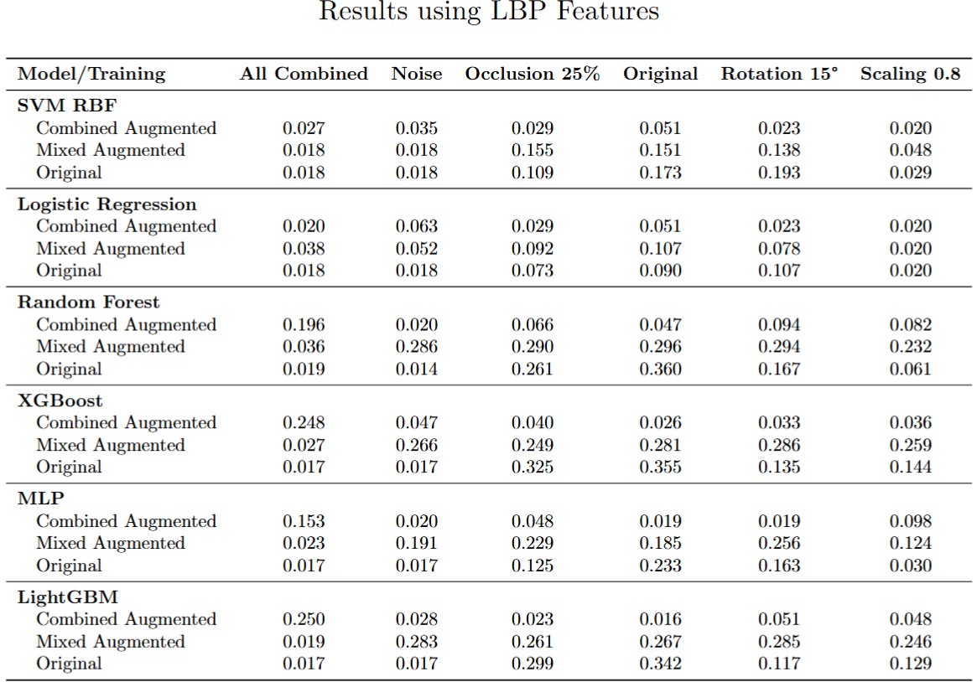

Slide 6
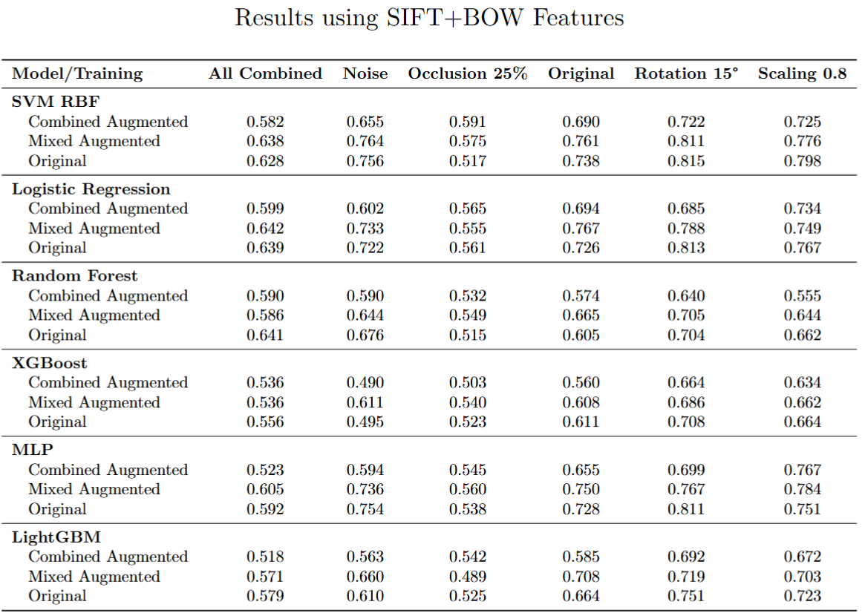

Slide 7
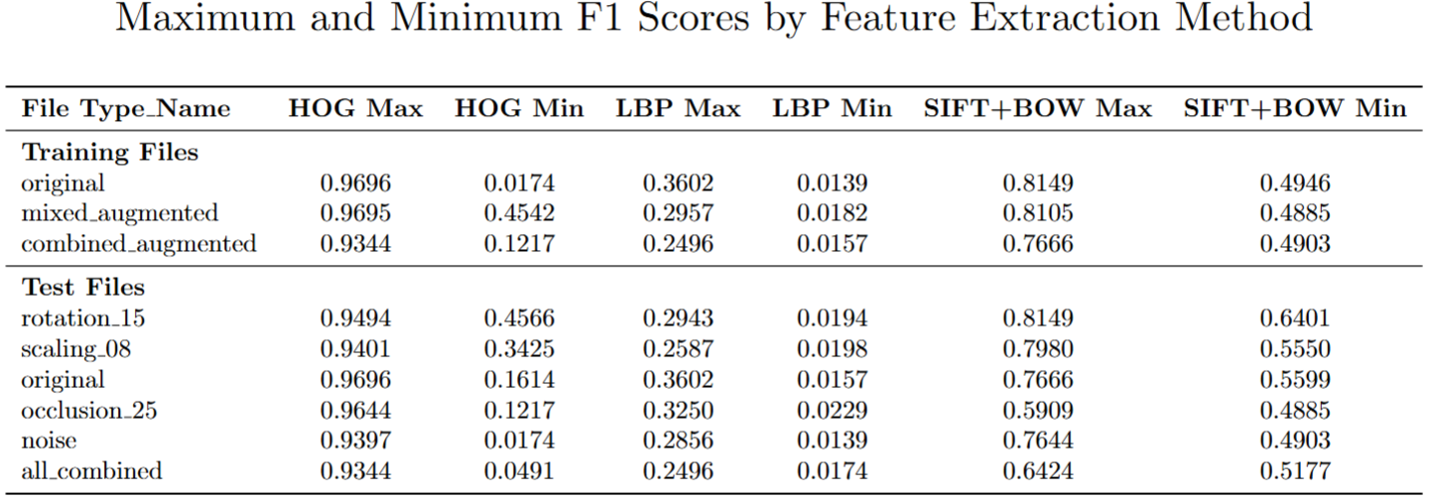
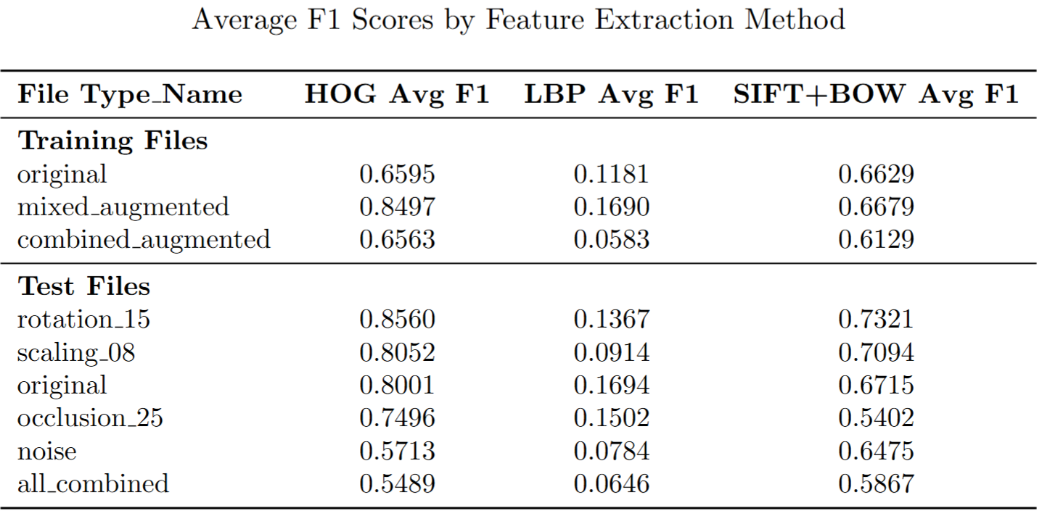
Performance Comparison

Slide 8
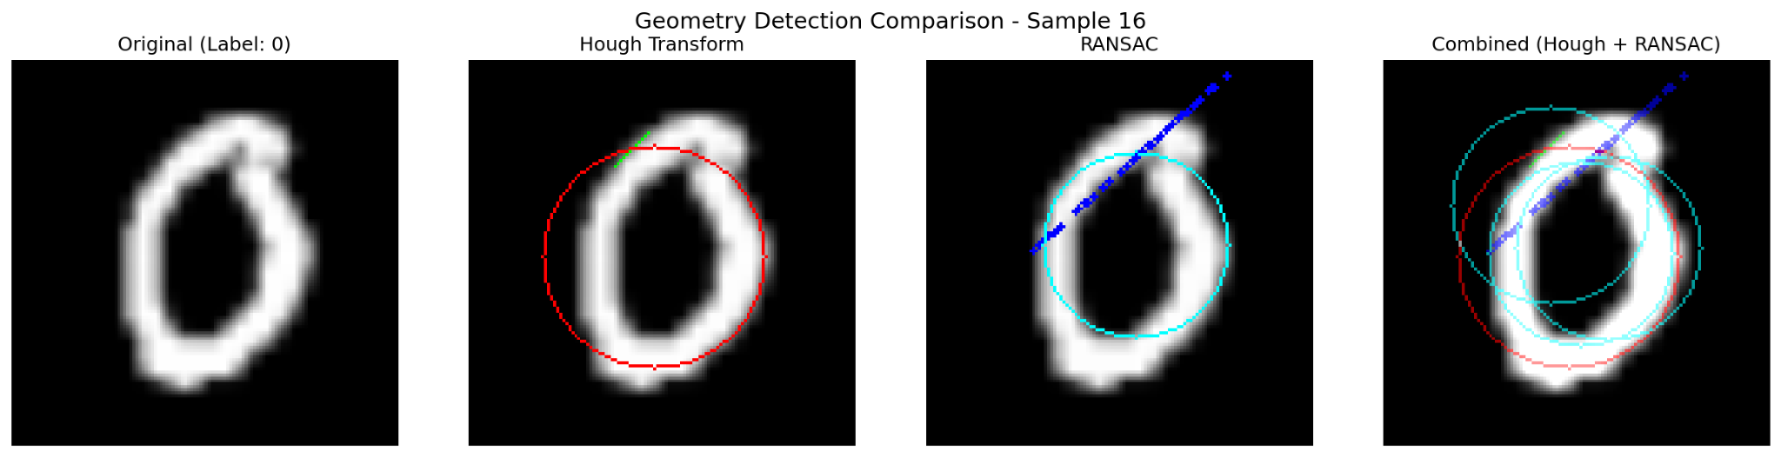
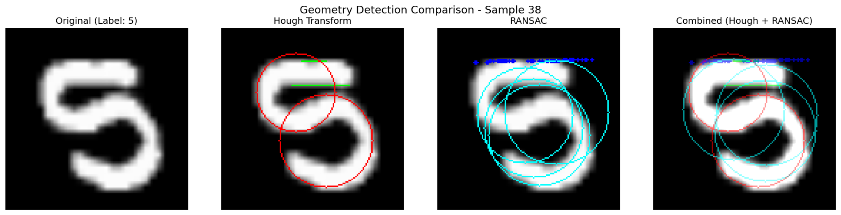
Geometry Feature Detection
Hough Transform Detection: Identifies lines and circles in images using classical computer vision.
Extracts: number of lines, line lengths/angles, circles, edge density
Significance: Captures structural geometric primitives in visual data
RANSAC Fitting: Robust geometric shape fitting resistant to outliers
Computes inlier ratios for line and circle models
Significance: Provides noise-resistant geometric measurements

Slide 9
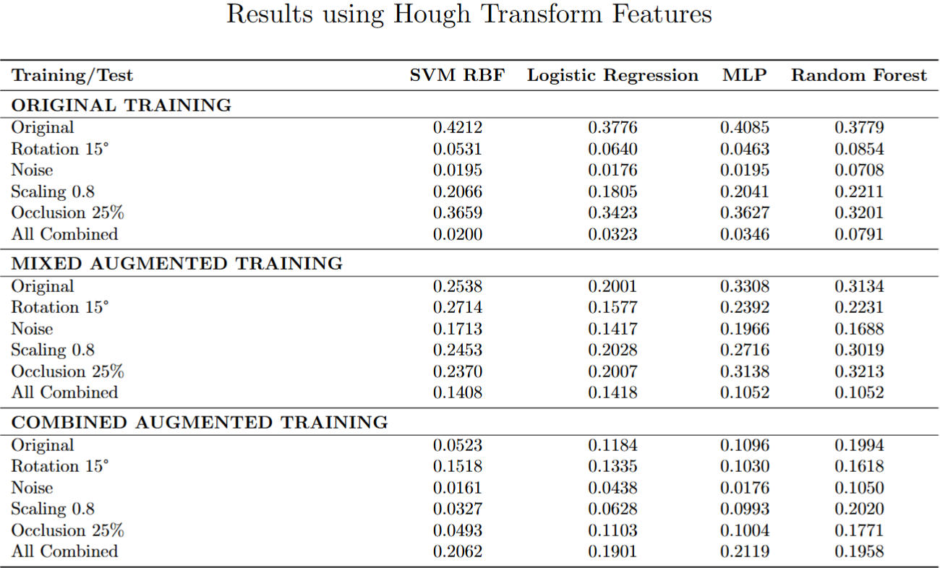

Slide 10
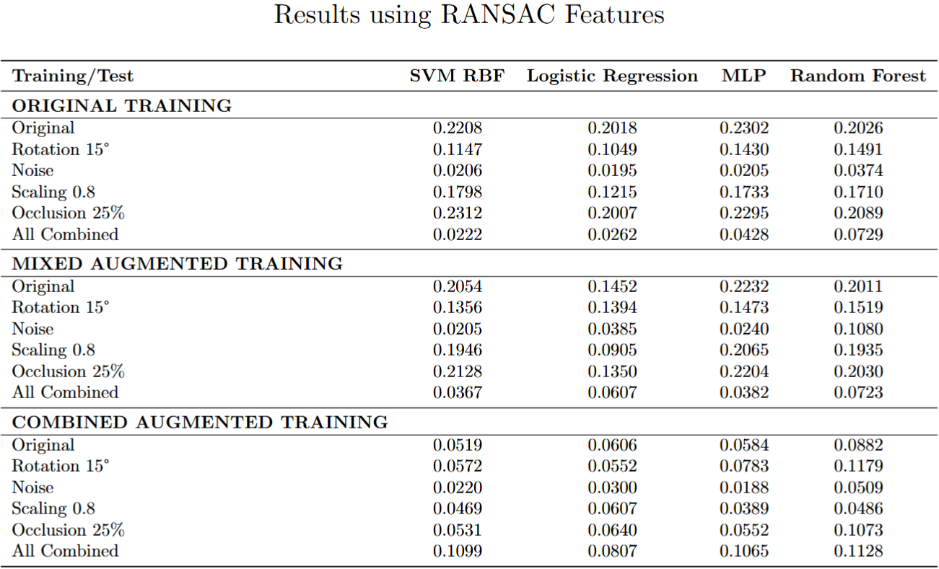

Slide 11
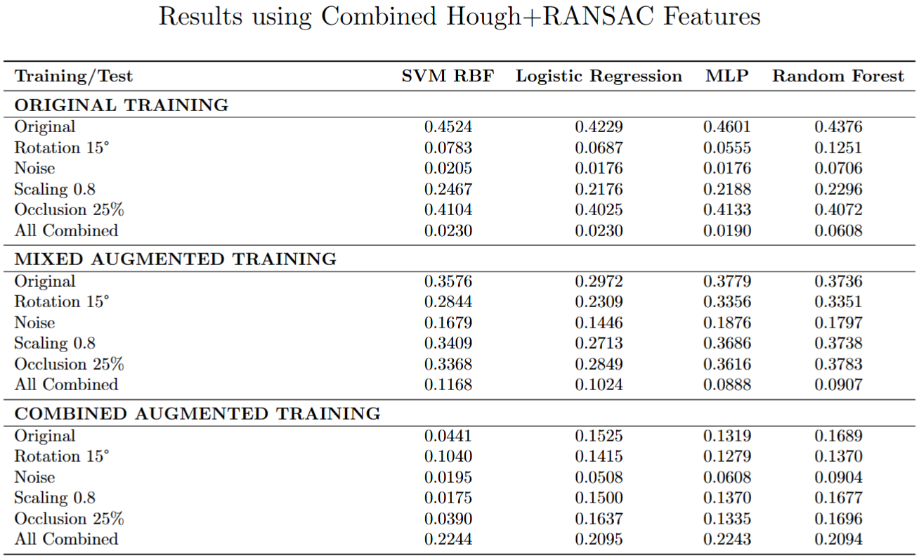

Slide 12
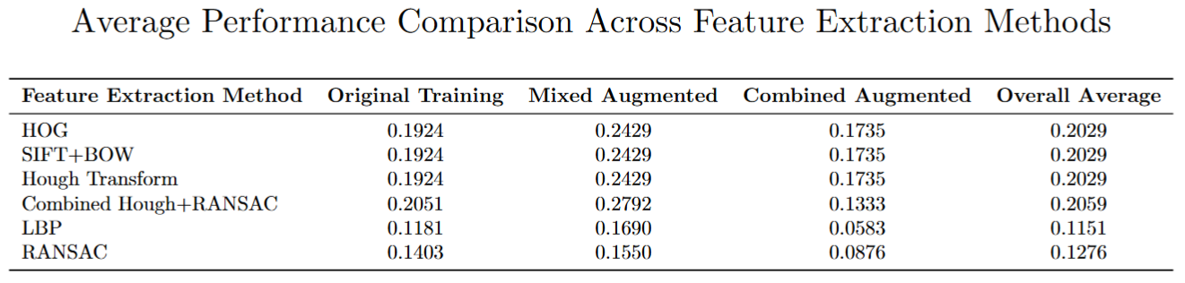

Slide 13
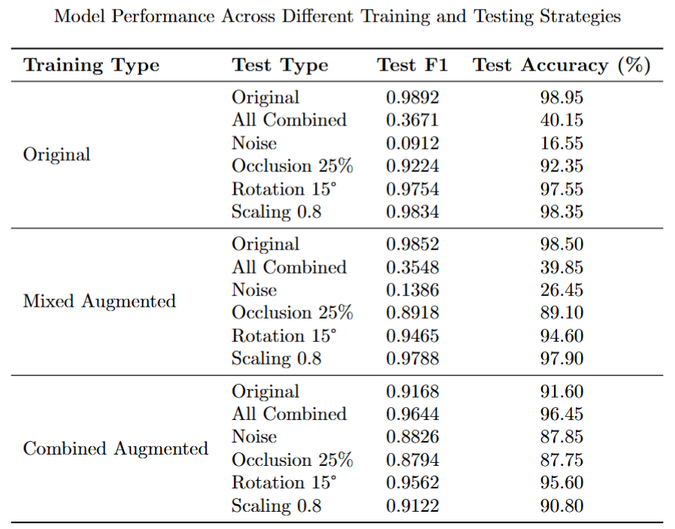
ResNet-18
Pretrained ResNet-18: Uses ImageNet-pretrained weights (IMAGENET1K_V1)
Significance: Leverages learned low-level features (edges, textures) for faster convergence

Slide 14
CLIP - Contrastive Language-Image Pre-training
CLIP (ViT-Large/14): OpenAI's contrastive vision-language model
Template Sets (4 Variations)
Basic: Simple noun phrases
Example: "a photo of the number {}"
Significance: Baseline performance with minimal context
Descriptive: Visual attributes and modifiers
Example: "a handwritten digit {}", "a blurry photo of a {}"
Significance: Tests if detailed descriptions improve alignment
Context: Semantic framing and scene descriptions
Example: "a black and white image of number {}", "a {} in the scene"
Significance: Provides domain-specific context (handwriting, photography)
Minimal: Bare class labels
Example: "{}"
Significance: Tests necessity of linguistic structure

Slide 15
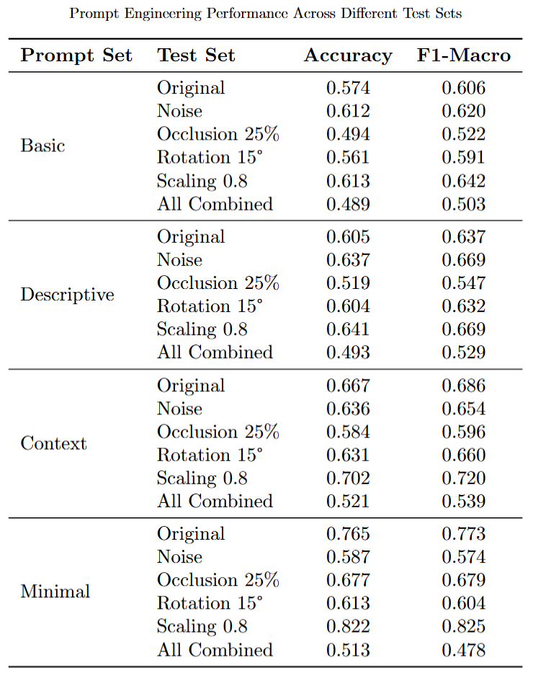
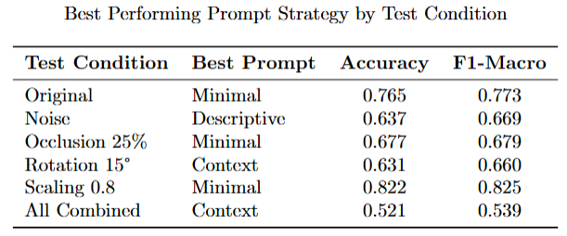

Slide 16
Conclusion
Traditional Methods (HOG, LBP, SIFT + BoW) - Offered interpretability, efficiency, and low computational cost but limited generalization.
Geometric Methods (Hough Transform, RANSAC) -
Focused on shape-based structural detection rather than classification.
Demonstrated strong robustness under occlusion and noise, but lacked semantic discrimination.
Deep Learning-Based (ResNet-18)
Leveraged ImageNet-pretrained ResNet-18 for supervised learning on MNIST.
Learned hierarchical features directly from pixel data through convolutional layers.
Required more computation but delivered state-of-the-art results.
CLIP-Based (Zero-Shot Vision-Language Model)
Descriptive and contextual prompts produced the best performance.
Demonstrated semantic flexibility and transferability, bridging vision and language understanding.

Slide 17
Thank You

